Slide 1
QUANTITATIVE VS. QUALITATIVE RESEARCH

Slide 2
1. Qualitative research
Qualitative research seeks to explain the way people understand everyday life and life situations
Depending on the researcher: there is no single, generally accepted way of conducting qualitative research
The key dilemma: philosophical vs. methodological (ontology and epistemology)
Unstructured answers: observation is not enough, understanding is also needed
Many tools and techniques: harmony between research methods (attitude analysis, observation, interviews, documentary analysis, etc.)
Ethical problem: minimal influence of researchers
There are various factors that can influence the inappropriate choice of a qualitative research method, such as limited budgets or deadlines leading to the choice of a small range of qualitative methods.

Slide 3
Qualitative research - when used
The less specific the goal
Understanding motivation and new concepts
When it is difficult to develop specific problem statements or research goals
When the research goal is to understand a deeper phenomenon
When the research goal is to find out how a phenomenon takes place in the natural environment or to learn how to express some terms in everyday language
When the behavior being researched is context dependent
When a "fresh" approach to a research subject is needed

Slide 4
Types of qualitative research
1. Theoretical research - aims to test, generate or improve thinking within a particular discipline.
2. Applied research - aims to contribute to the understanding or solution of contemporary (current) problems, evaluation of policies (poverty, health, education,…)

Slide 5
The most common techniques
Focus group interview
In-depth interview
Conversations
Semi-structured interview
Word associations / sentence completion
Observing
Collages
Thematic apperception / cartoon tests

Slide 6
Tools | Description | Benefits | Disadvantages
Focus group interview | Small group discussions led by a trained moderator | It can be implemented quickly Lots of perspective Flexibility | The results depend on the moderator The results are not generalized to the whole population Hard to implement in case of sensitive topics Expensive
In-depth interviews | One on one interview Researcher and respondent | Insight is gained from each individual Good for understanding unusual behavior | Results depend on the interpretation of the researcher The results are not adjusted for generalization Very expensive
Conversations | An unstructured dialogue recorded by a researcher | A unique insight is gained It can cover sensitive topics Less expensive | Easy to "deviate" from the topic Interpretation depends on the researcher
Semi-structured interviews | Open questions Often written form An essay type of answer is often asked | More problems can be touched on The results can be easily interpreted Cost advantage | There is a lack of flexibility for new knowledge
Word associations / sentence completion | Records the first thoughts that come because of the stimulus | Economically It can be taken quickly | There is a lack of flexibility for new knowledge
Observing | Records descriptions of observed events | It can be unobtrusive Behavioral patterns can be learned | It can be very expensive
Collages | Respondents provide images that depict their experiences and feelings | Flexible for new knowledge | Very dependent on the interpretation of the researcher
Thematic apperception / cartoon test | The researcher presents ambiguous images about which the respondent tells a story | Projective, allows talking about sensitive issues Flexible | Very dependent on the interpretation of the researcher

Slide 7
Any research tool can be misused and misused. Qualitative research has a great deal in subjectivity and care should be taken when interpreting it.
Another important feature that any research should have, in addition to objectivity, is the ability to replicate or repeat research and come to similar conclusions.
And in qualitative research, both characteristics have been questioned.

Slide 8
2. Quantitative research
Quantitative research is the systematic empirical research of observable phenomena using statistical, mathematical, or computational techniques.
The aim of quantitative research is to develop and use mathematical models, theories and / or hypotheses related to social phenomena.
The central process of quantitative research is the process of measurement because it enables the connection of empirical observations and mathematical expression of quantitative relations.
They are most often performed on a sample, with the hope that the results can be generalized to the population.
Empirical assessment
Numerical solutions
Analytical processes

Slide 9
Assumptions of quantitative (nomothetic) explanations
Connection
Time sequence
Nonspuriousness _ _
Mechanism
Context

Slide 10
Types of quantitative analyzes
Multivariate methods ; methods of factor analysis (factor analysis of common factors, analysis of major components, elimination of factors, orthogonal, varimax and oblique rotation of factors); model of discriminant analysis (prerequisites for application, development of discriminant function, direct and stepwise method of discriminant analysis). The emphasis is on the interpretation and validation of results.
Linear programming (geometry of linear programming, simplex method, Charnes Big-M method, duality and economic interpretation, sensitivity analysis, transport and assignment problems, integer linear programming); classical optimization without constraints and with constraints in the form of equations, Lagrange multipliers, and selected methods of numerical optimization; nonlinear programming (Karush-Kuhn-Tucker optimality conditions, convex and quadratic programming). The emphasis is on software to solve illustrative economic and business problems on the computer, with an emphasis on the interpretation of results.
Time series ; least squares method (OLS), ARMA, ARIMA, GARCH, MIDAS, vector autoregression, cointegration, structural models, etc.
Panel analysis : panel method, GMM, cointegration panel, etc.

Slide 11
Example Table. Testing the importance of trend components in variable commodity exchange conditions
Independent variables | Regression: dependent variable lnTOT
 | 1 | 2
α | - 0.046 *** | - 0.024 ***
β | 0.003 *** | 0.002 ***
ρ | / | 0.447 ***
β / (1 - ρ) | / | 0.004 ***
Corrected R ² | 0.910 | 0.921
LM (χ ² ) test (4) | p-value = 0.030 | p-value = 0.795
ARCH (χ ² ) test (4) | p-value = 0.558 | p-value = 0.275
***, **, * represent 1%, 5% and 10% significance levels
Source: Author's calculation.
lnTOT _{t} = α + βT + ε _{t} (1)
and suggests the existence of a statistically significant positive trend in the movement (growth) of trade conditions of the Republic of Croatia of 1.2% ( β parameter ) per year. However, this regression is marked by the problem of serial correlation (especially visible in the LM test), as well as the problem of heteroskedasticity and relationship stability, so as such it is not useful to us. To correct the residual autocorrelation problem, we will add a lagged dependent variable (one time shift) to equation under (2) so that ρ represents the autoregressive parameter.
lnTOT _{t} = α + βT + ρ (lnTOT _{t-1} ) + ε _{t}
The regression results show that the inclusion of the lagged variable reduced the trend coefficient, however, all parameters remained statistically significant. The regression under (2) also suggests a positive trend of approximately 0.8% per year, however, the long-term parameter given as β / (1 - ρ) shows a statistically significant positive trend growth of 1.4% per year. LM and ARCH tests do not show an autocorrelation problem. The regression is therefore adequately set up so as not to indicate any problem of deviation normality and relation stability (recursive deviations, CUSUM test and CUSUM square test), although it shows a small heteroskedasticity problem (as we observe time series, this problem is negligible).
Estimates are based on seasonally adjusted and logarithmic quarterly data, so if we want to get annual data, we have to multiply quarterly results by 4, and again by 100 to get a percentage. The parameter ε _{t} represents random deviations in regression (we will use the same notation in the continuation of the paper).

Slide 12
Qualitative vs. quantitative research
Qualitative research | Research aspect | Quantitative research
Discover ideas It is used in exploratory research with general research objectives | Common purpose | Tests hypotheses or specific research questions
Observe and interpret | Access | Measure and test
Unstructured, free form | Access to data collection | Structured answers Certain categories
The researcher is involved The results are subjective | Researcher independence | The researcher is an uninvolved observer The results are objective
Small specimens - often in a natural environment | Samples | Large samples leading to general results (results that can be applied to other situations)
Exploratory research design | Most commonly used | Descriptive and causal research design

Slide 13
Examples
An example of qualitative research
https://hrcak.srce.hr/index.php?show=clanak&id_clanak_jezik=181021
Example of quantitative research
https://hrcak.srce.hr/index.php?show=clanak&id_clanak_jezik=315433

Slide 14
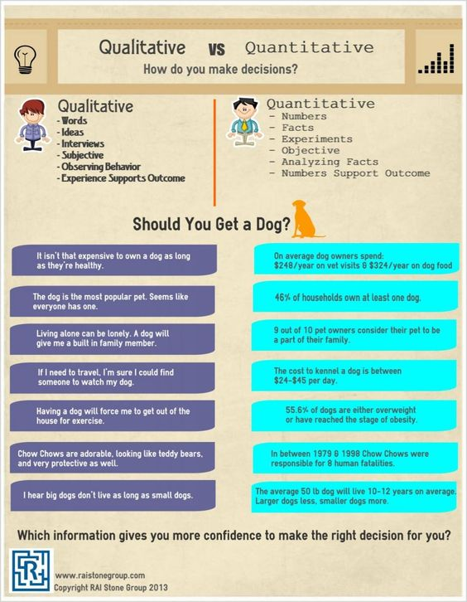

Slide 15
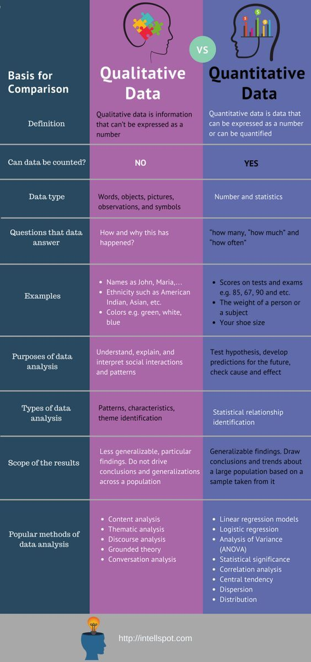

Slide 16
An example of combining quantitative and qualitative research
Research on the homeless
qualitative research : it would investigate the nature of homelessness, how it arises, what are the effective methods of prevention
quantitative research would measure the level of homelessness, the prevalence among the population, the extent to which homeless services are used and how many are needed for the future

Slide 17
Inclusive
Although the application of qualitative research is virtually limitless , there is still resistance to the use of qualitative methods, especially where there is a dependence on numbers
“A clear and solid structure of qualitative analysis is very important through which all creative tasks can be explored. In this regard, there is hope that what at first seemed like a hopeless swamp will be transformed into a picturesque landscape, with solid borders and fullness of color . ”
Researchers choose what is more practical for them !!!

Slide 18
Question 1:
What type of quality techniques would you use in the following situations:
1. The President of the Management Board of the Hotel Group suggests the development of service quality in such a way that the emphasis is on a positive experience during check - in activities in hotels
2. The production team wants to launch a spin - off of the famous series
3. The marketing manager wants to identify the symbolism associated with eating at McDonald’s restaurants.

Slide 19
Question 2:
The manufacturer of packaged products receives thousands of letters from consumers each year. Some letters are complaints, some are praises. They cover a wide range of topics. Are these letters a possible source of qualitative and / or quantitative research? On what way?

